Slide 1
Style and Color
Module 02
Data Science Developer

Slide 2
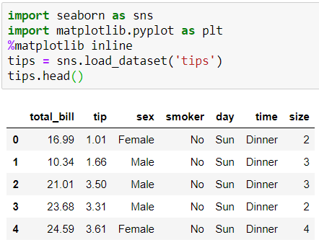
Imports and Data

Slide 3
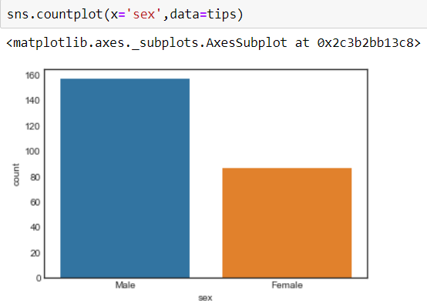
Styles
You can set particular styles:

Slide 4
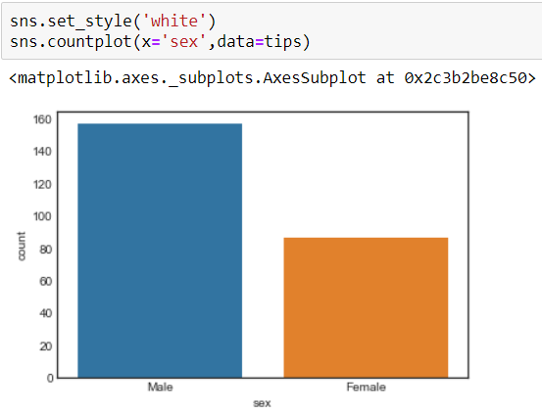

Slide 5
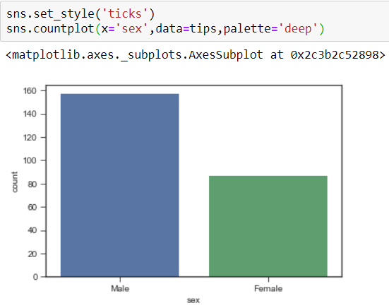

Slide 6
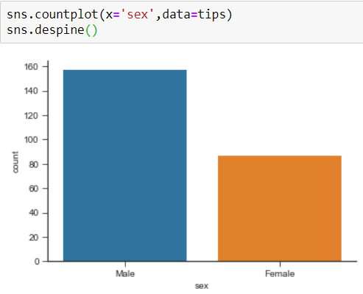
Spine Removal

Slide 7
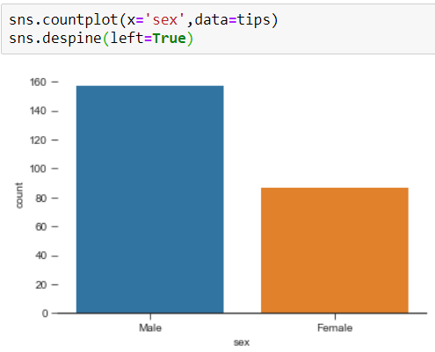

Slide 8
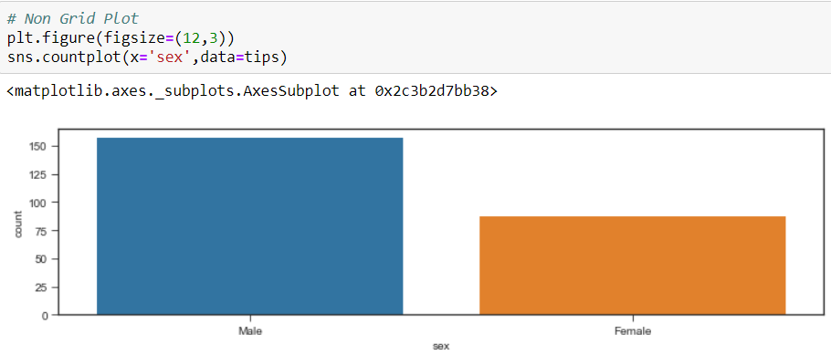
Size and Aspect
You can use matplotlib's plt.figure(figsize=(width,height) to change the size of most seaborn plots.
You can control the size and aspect ratio of most seaborn grid plots by passing in parameters: size, and aspect. For example:

Slide 9
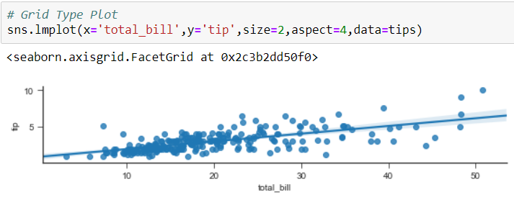

Slide 10
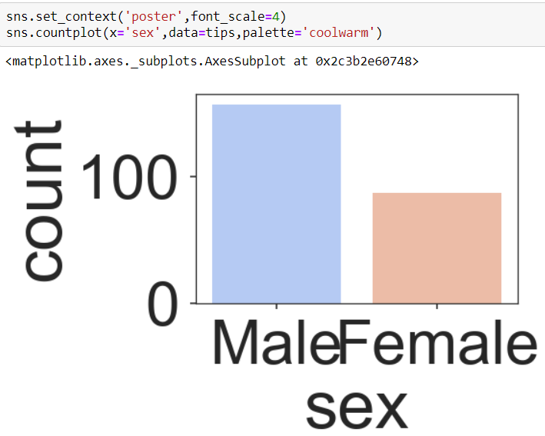
Scale and Context
The set_context() allows you to override default parameters:

Slide 11
For more Info
Check out the documentation page for more info on these topics: https://stanford.edu/~mwaskom/software/seaborn/tutorial/aesthetics.html

